Slide 1







Analysis on Why Women and Children are Vulnerable for Human Trafficking in India
TEAM RECORD KEEPERS
Jeoma Raye Alejandrino Almazan Mary Joy Lasco
Rico Littawa
Xielo Jeff Manalo
Marnel Javier Valentin

Slide 2

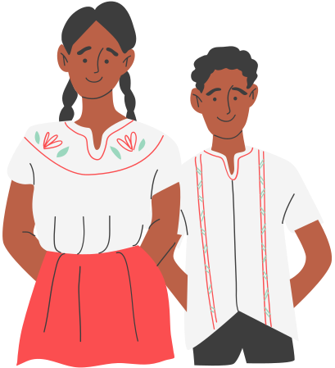

Hi I'm Anna
Hi I'm Jacob

Slide 3

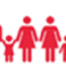

OBJECTIVE
. To determine why women and children in India are prone to human trafficking.
To determine the main purpose and agenda of human trafficking in India.
To be able to raise awareness regarding human trafficking most especially to the country of India and to create solution on how to prevent it.

Slide 4


PROBLEM
Why Women and Children are Vulnerable for Human Trafficking in India

Slide 5

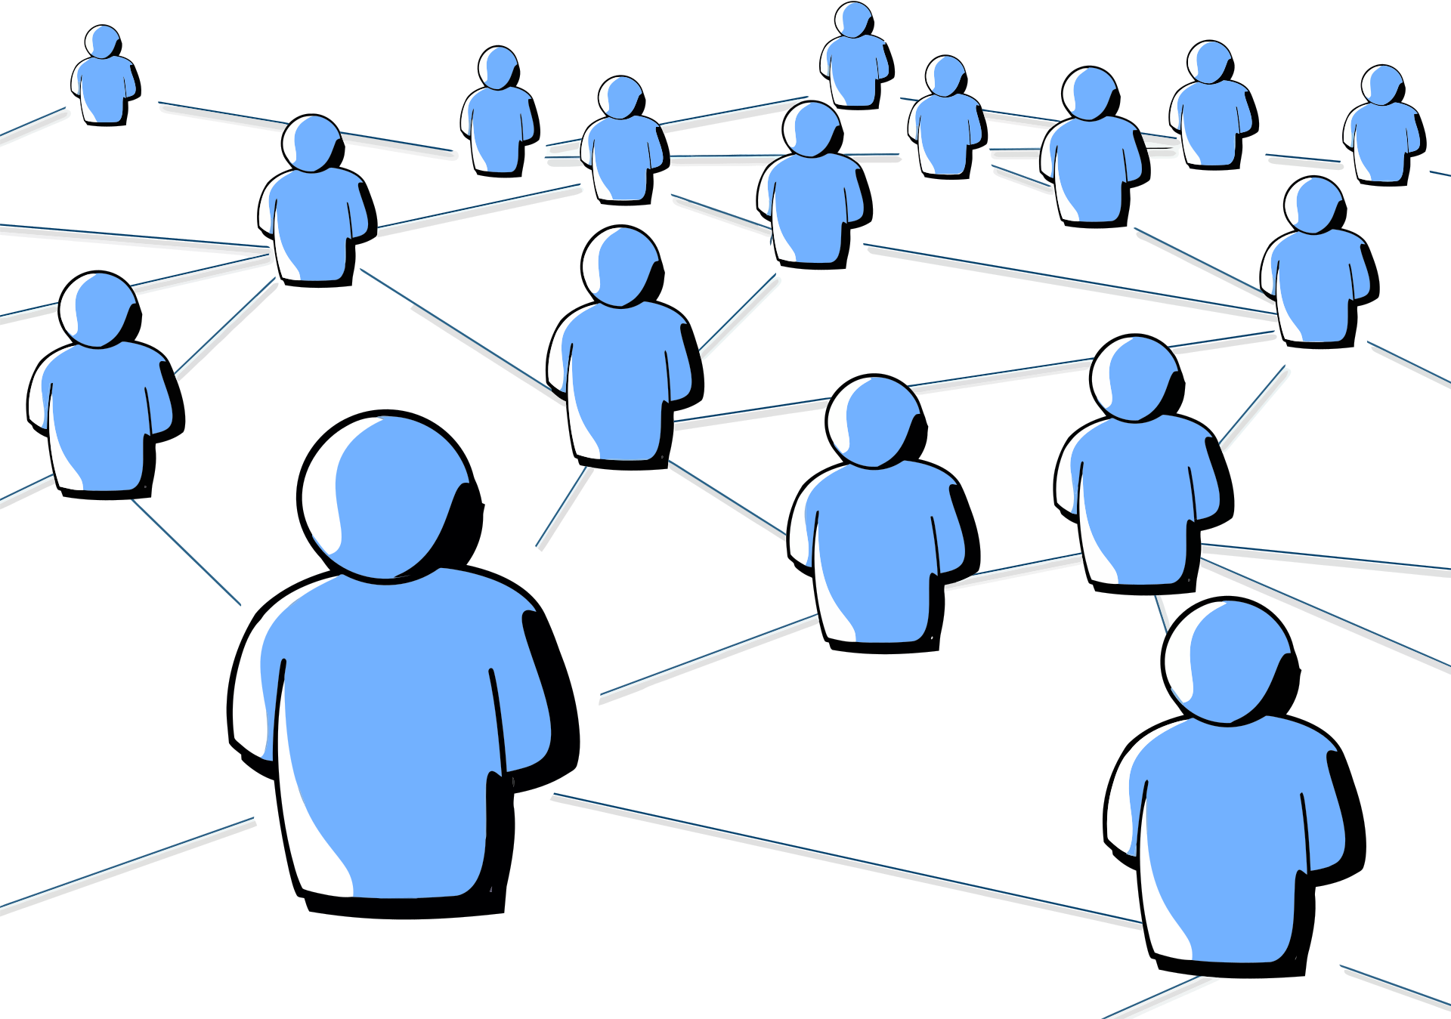
PRESENTATION OF DATA

Slide 6
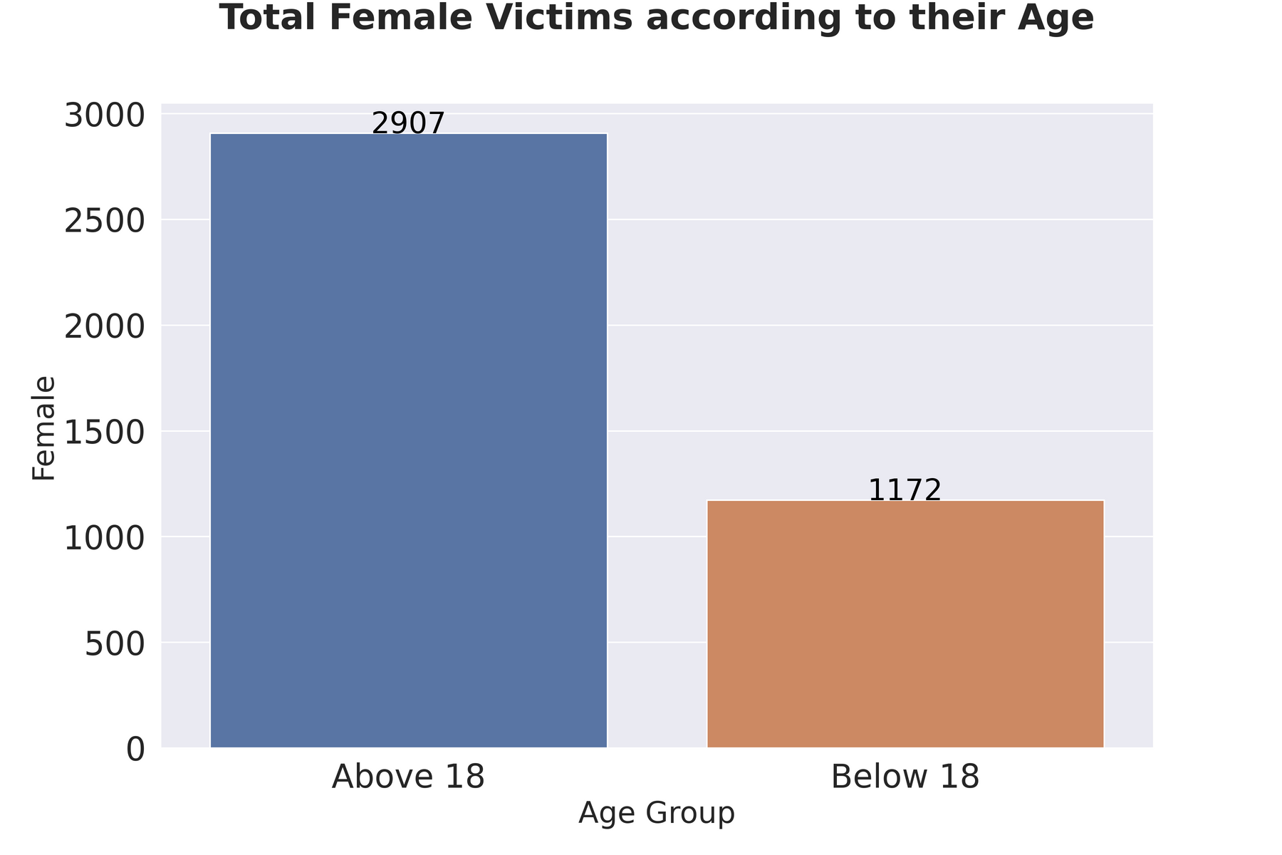

FEMALE VICTIMS
TOTAL OF
2907
of female victims are above 18

Slide 7
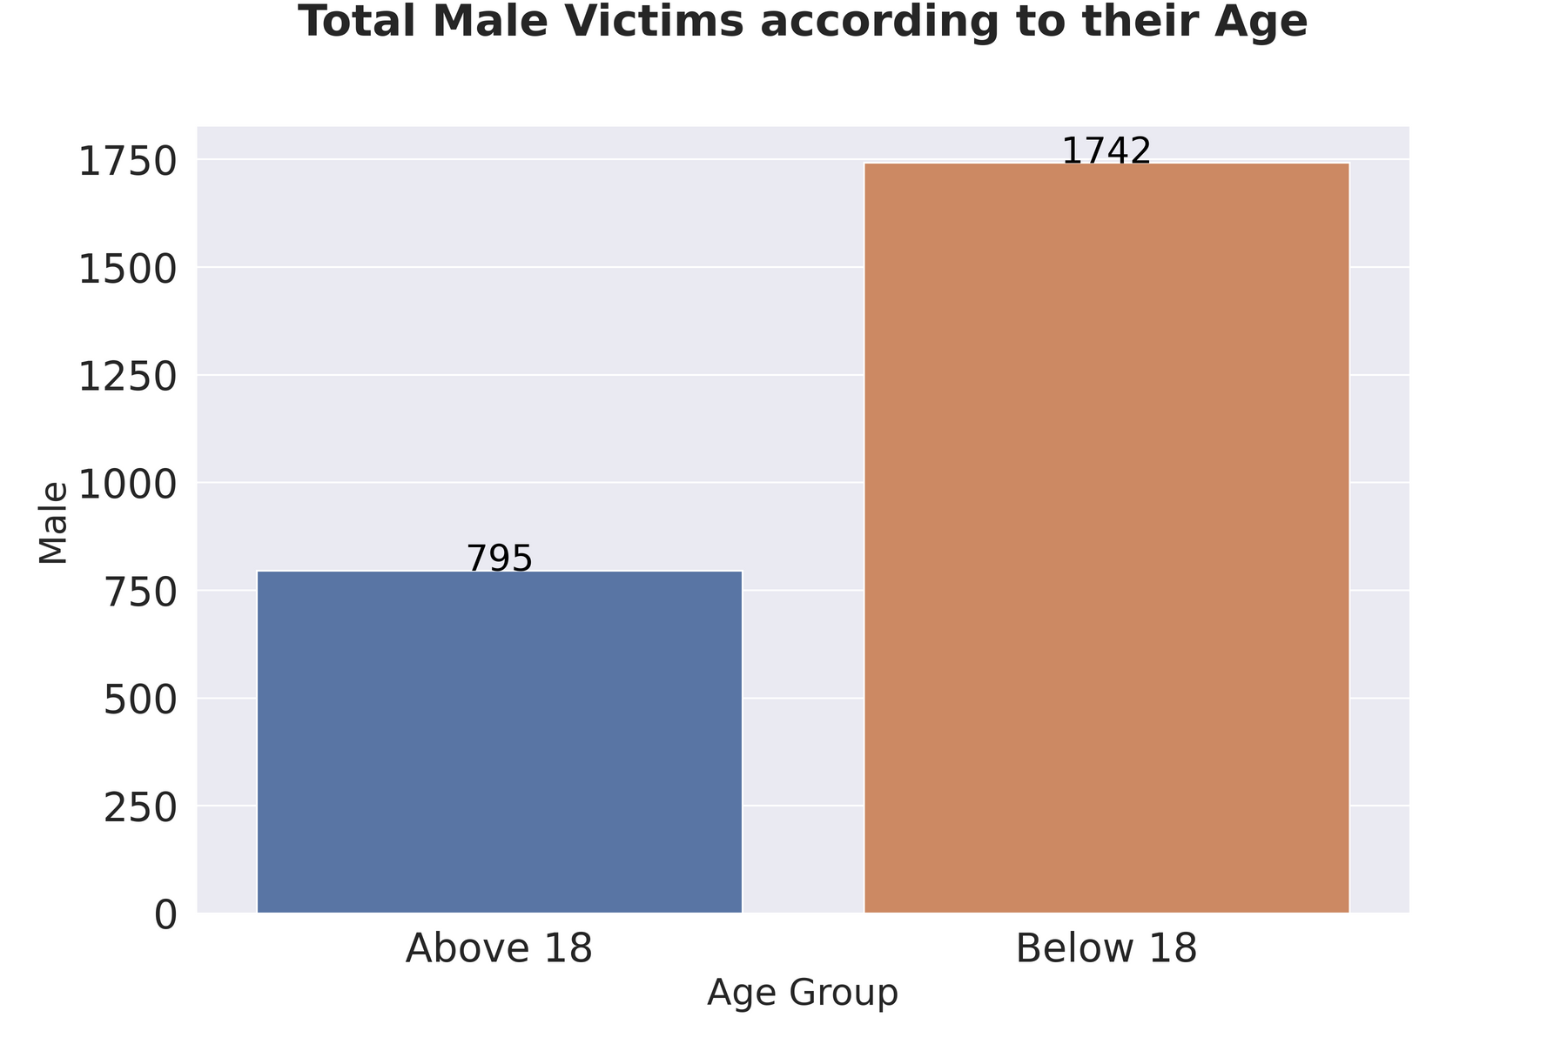

MALE VICTIMS
TOTAL OF
1742
of male victims are below 18

Slide 8
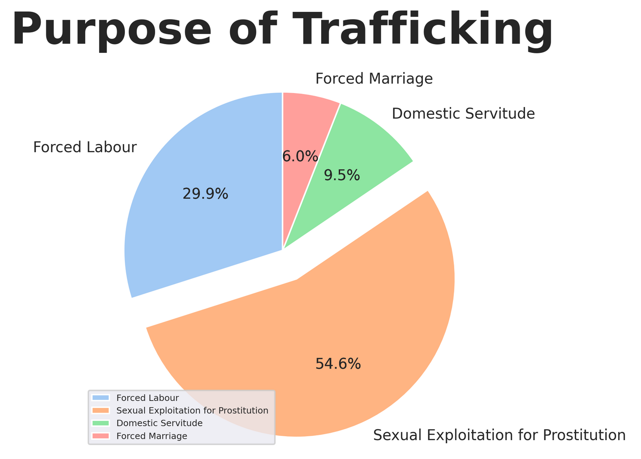

01 Reason
SEXUAL EXPLOITATION
According to the United Nations Office on Drugs and Crime's 2009 report, the most common reason for human trafficking is sexual exploitation which is primarily affects women and girls.

Slide 9
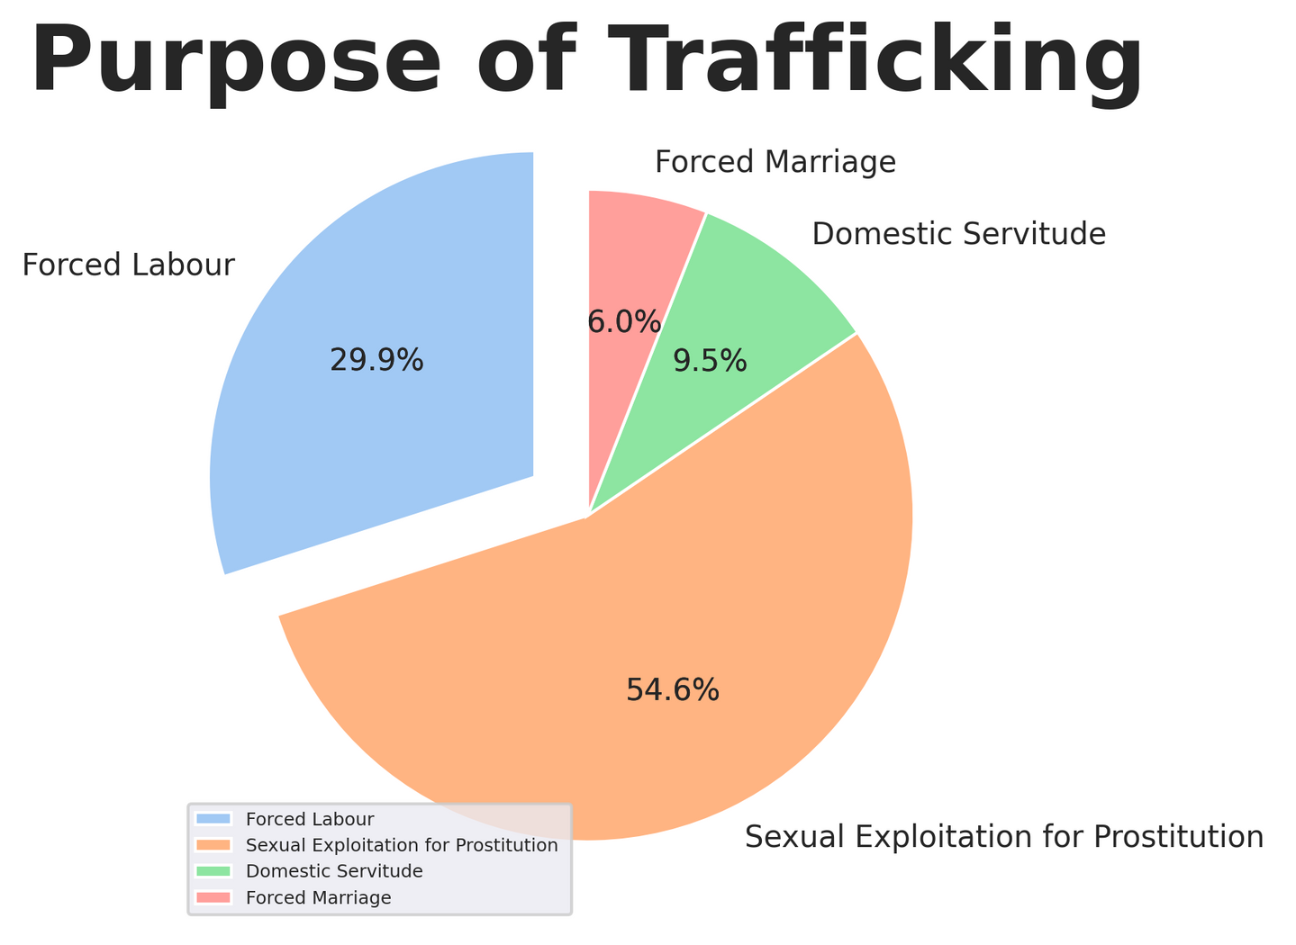
02 Reason
FORCE LABOR
According to the Protocol to Prevent, Suppress, and Punish Human Trafficking in Persons, Particularly Women and Children, between 2012 and 2014, around four out of every ten victims were trafficked for forced labor, with men accounting for 63 percent of the victims.

Slide 10
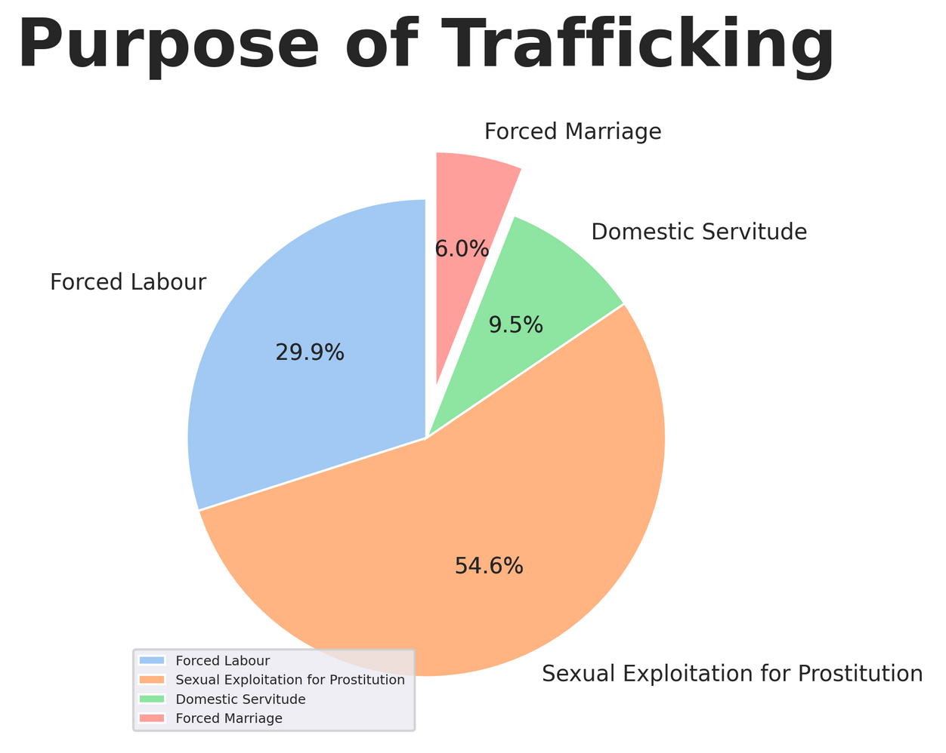
Least common reason
FORCE MARRIAGE

Slide 11
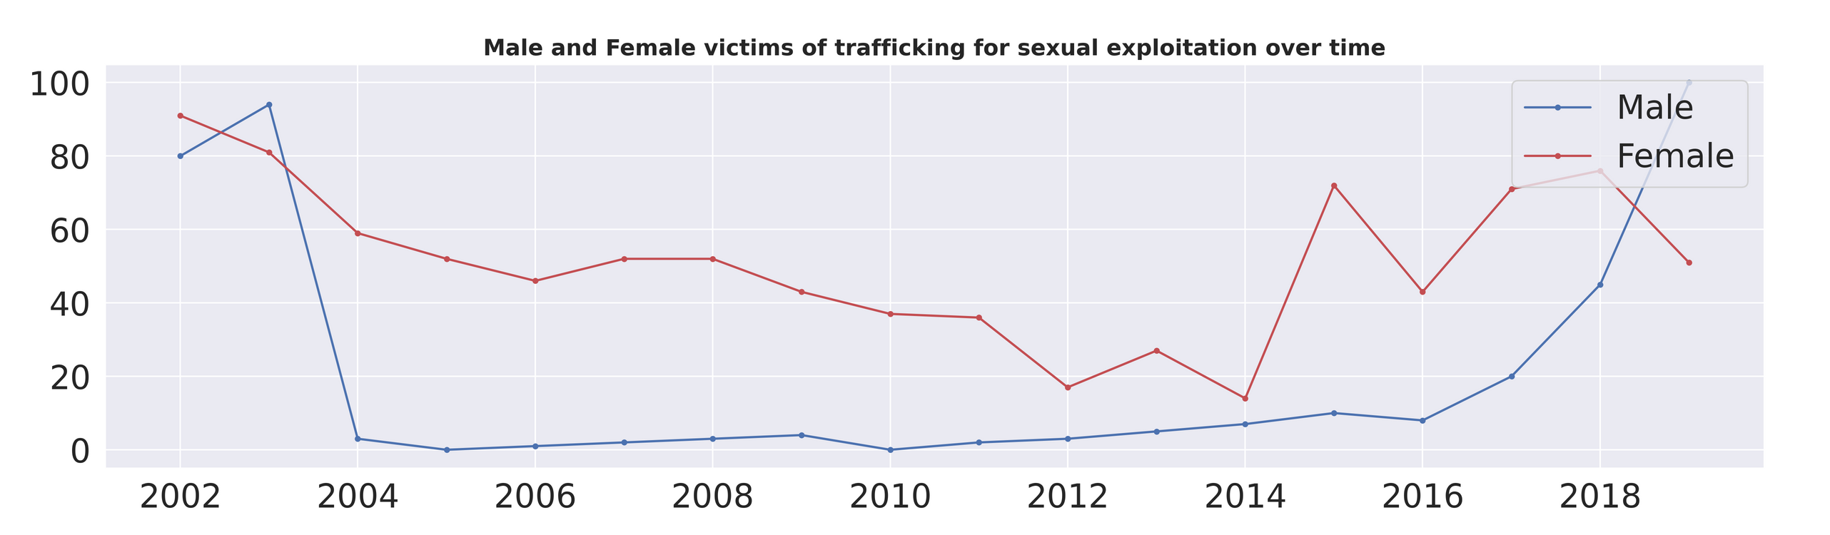


Male and Female Victims for Sexual Exploitation Over Time
YEAR 2018
Up to 2018, the proportion of female victims who were sexually exploited has progressively dropped, while the number of male victims has increased.

Slide 12
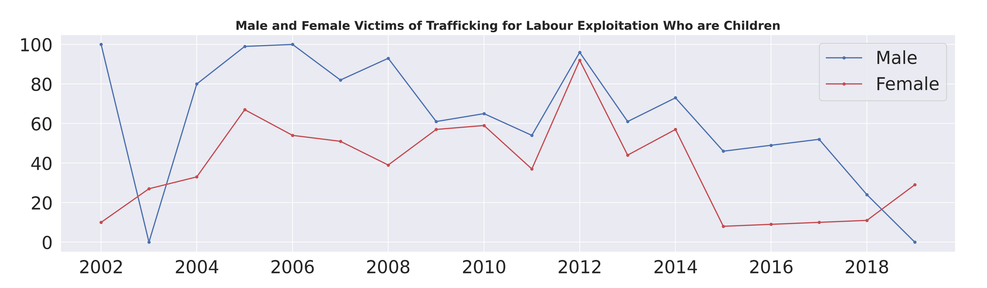
Male and Female Victims for Labor Exploitation Over Time
YEAR 2016-2018
Male victims are decreasing in year 2018 and female victims slightly increased.

Slide 13
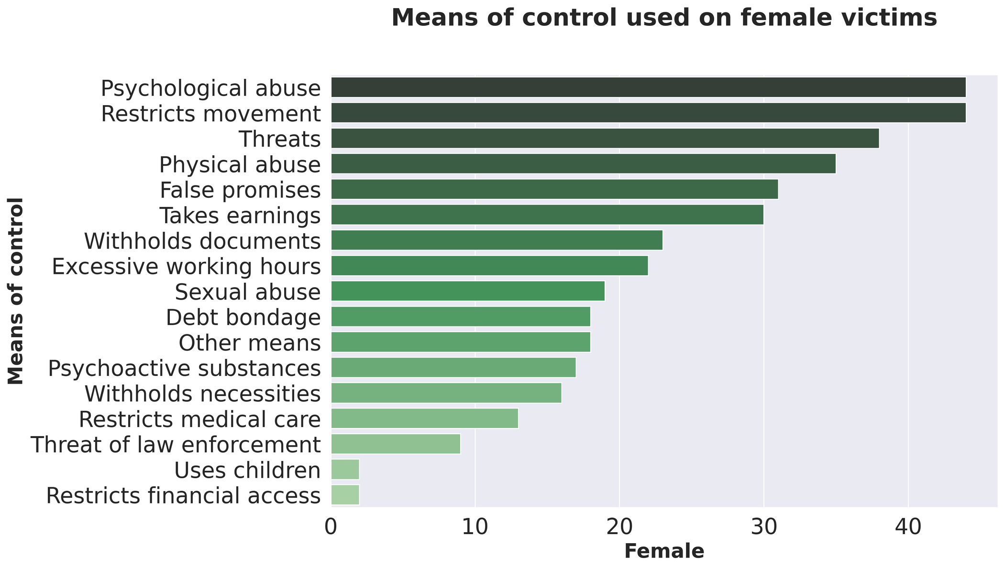
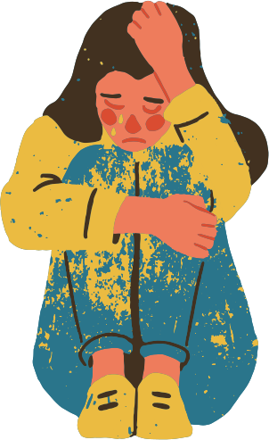
Means of Control used on Female Victims

Slide 14

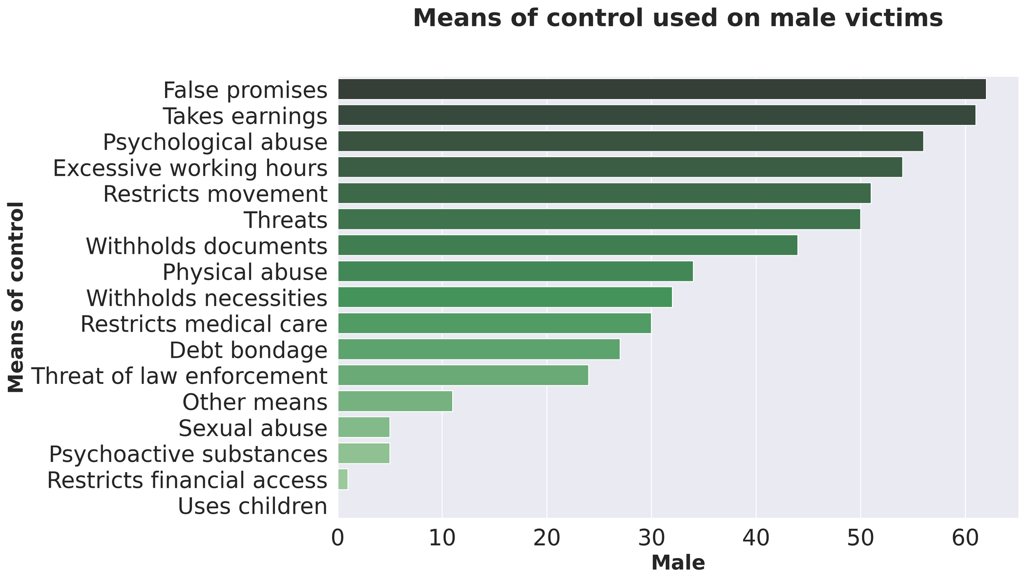
Means of Control used on Male Victims

Slide 15
CONCLUSION

Slide 16
RECOMMENDATION

Slide 17
Thank you

